Slide 1
Periodic Trends- Electronegativity

Slide 2
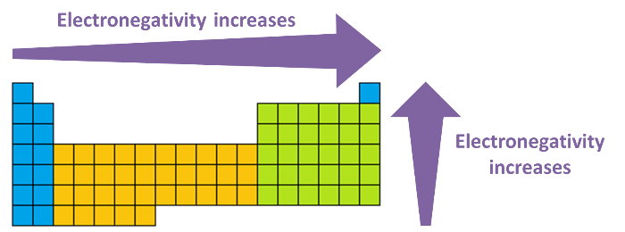
In this Smart Lesson you will learn to:
Define electronegativity.
Describe and explain trends in electronegativity in the periodic table.

Slide 3
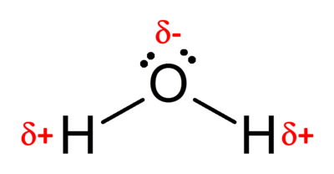
Electronegativity is a measure of an atom's tendency to attract a bonding pair of electrons.
The attraction an atom has for electrons depends on the number of protons in the nucleus, the distance between the nucleus and the bonding electrons (i.e. atomic radius), and the shielding effects from electrons in inner shells.
A large electronegativity value means the attraction between the nucleus and the bonding electrons is strong.
When two elements are bound together that have different electronegativities a polar bond is formed. This is because the electron density is higher around one atom than the other. For example, in water, oxygen has a higher electronegativity than hydrogen so the electrons in the O−H bond are found closer to the oxygen atom than the hydrogen atom. (The δ symbol represents a small amount of charge).

Slide 4
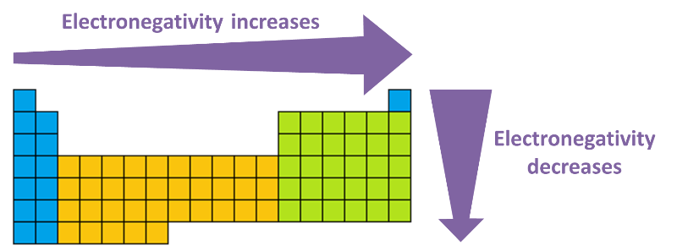
Electronegativity increases across a period and decreases down a group.
This means that the most electronegative atoms exist at the top-right corner of the periodic table with the exception of the group 18 noble gases, which do not have electronegativity values. An easy way to remember this is that fluorine is the most electronegative element, and the farther you go from fluorine, the less electronegative the element will be.

Slide 5
What causes the changes in electronegativity?
Across a period the electronegativity increases because the number of protons in the nucleus increases while the valence electrons are in the same energy level. This means the electrostatic attraction between the nucleus and the electrons is stronger.
When going down a group the increase in atomic radius means that electrons are situated farther away from the nucleus, so the electrostatic attraction and thus electronegativity decreases.

Slide 6
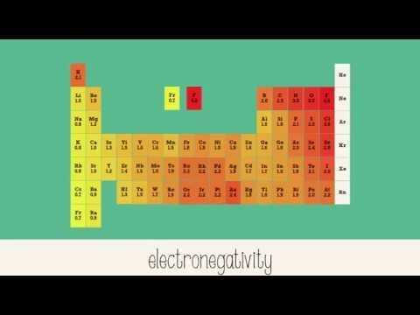

Slide 7
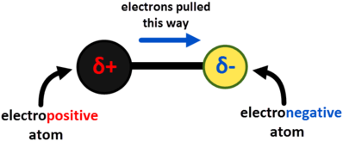
Electronegativity is measured on a relative scale known as the Pauling scale.
The most electronegative element is fluorine, and it was arbitrarily given a value of 4.0 on the Pauling scale and all other elements were measured relative to this.
Pauling proposed the concept of electronegativity in 1932 to explain the fact that some experimentally observed covalent bond strengths were stronger than the theoretical ones. Pauling reasoned that this difference in bond strengths was due to an additional ionic contribution to the bond due to uneven sharing of electrons.

